Slide 1

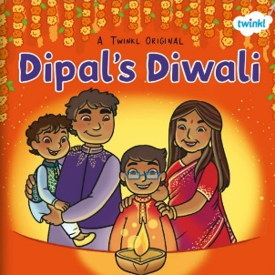






PROJECT PLACEMAT – I WONDER WHAT CHANGES?
Sticky knowledge
I know that Diwali is a special celebration.
I know some of the ways that people prepare for and celebrate Diwali.
I know that in Autumn the leaves change colour and start to fall.
I know that in Winter it gets colder and the trees are bare.
I know what nocturnal animals are and can name some of them.
I know that some animals hibernate during winter and can explain what hibernating means.
I know how I will change when I get older.
I know that dinosaurs lived a very long time ago.
I can name some dinosaurs and talk about their features.
I know that Christmas is a special celebration.
I know some of the ways people prepare for and celebrate Christmas.
I know which festivals are important to me and talk about my own experiences.
Key Questions:
How do people celebrate Diwali?
What is awake when I am asleep?
Where do animals go in winter?
What were dinosaurs like?
When were dinosaurs alive?
Why do people celebrate Christmas?
The 5 C’s
Confidence – performing to others
Cooperation – sharing and taking turns
Courtesy – Anti-bullying
Compassion – Remembrance and charity
Care – looking after ourselves and others
Key texts

Slide 2
PROJECT PLACEMAT – I WONDER WHAT CHANGES?
Key Vocabulary
Celebration – to do something special or enjoyable for an important event
Diwali – a Hindu festival of light
Diva lamps, Rangoli patterns, Mendhi, Rama, Sita, Lakshmi
Nocturnal – active (awake) at night
Seasons – different times of year when the amount of daylight and temperature changes
Hibernate – when animals go into a deep sleep for winter
Habitat – a place where an animal lives
Herbivore – a plant eater
Carnivore – a meat eater
Omnivore – a plant and meat eater
Christmas – a Christian festival celebrating Christ’s birth
Songs to practise at home each week:
Week 1: Clap your hands https://www.youtube.com/watch?v=6XyRIpP1Qkw
Week 2: Ten little fingers
https://www.youtube.com/watch?v=0Qa8vK_PAyY
Week 3: Open shut them
https://www.youtube.com/watch?v=pZjInx0GQqI
Week 4: Here is the beehive
https://www.youtube.com/watch?v=V5Bs9xydba0
Week 5: 10 little dinosaurs
https://www.youtube.com/watch?v=TjmGTbNLj6Q
Week 6: Tommy thumb
https://www.youtube.com/watch?v=VdK4XhDQ-a0
Week 7: 1,2,3,4,5 once I caught a fish alive
https://www.youtube.com/watch?v=--BhTBXdc1o

