Slide 1




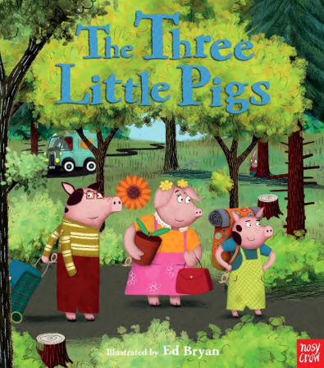

PROJECT PLACEMAT – I WONDER HOW THINGS WORK?
Sticky knowledge
I know where I live.
I know that there are different types of houses and homes.
I know that there are lots of different materials and I can name some of them.
I know that things work in different ways e.g. pushing, pulling
I know that some things happened a long time ago, before I was born.
I know that some materials can be recycled.
I know why things melt and freeze.
I know that some things float and some things sink.
I can describe how materials feel.
I know that some materials are strong and some are weak.
I know that some people celebrate Chinese New Year and can talk about some ways that people celebrate.
I understand that other people might not live in a house like me.
Key Questions:
Where do I live?
How do toys work?
How do houses stay up?
What are houses made of?
What floats and sinks?
Why do things melt and freeze?
How do people celebrate Chinese New Year?
How do other people live?
The 5 C’s
Confidence – sharing own experiences with others – show and tell
Cooperation – working together to build structures and complete experiments
Courtesy – understanding and respecting how others live
Compassion – understanding homelessness
Care – caring for our environment and others
NELI Key texts

Slide 2
PROJECT PLACEMAT – I WONDER HOW THINGS WORK?
Key Vocabulary
House – a building that people live in
Home – a place where someone lives
Homeless – a person without a home
Shelter – a place to protect or cover someone
Material – what something is made from
Strong – not easy to break
Weak – easy to break or bend
Melt – to become a liquid
Freeze – to become a solid
Float – to stay on the surface of the water
Sink – to go below the surface of the water
Chinese New Year – a special Chinese festival / celebration
Songs to practise at home each week:
Week 1: Tommy thumb
https://www.youtube.com/watch?v=VdK4XhDQ-a0
Week 2: 1,2,3,4,5
https://www.youtube.com/watch?v=gM7uO4WyE-8
Week 3: The Dragon Song
https://www.youtube.com/watch?v=by5sTzh67fU
Week 4: Little Peter Rabbit
https://www.youtube.com/watch?v=7iIRpmxkmGE
Week 5: Wind the bobbin
https://www.youtube.com/watch?v=WwdxJnAA6CI
Week 6: 5 currant buns
https://www.youtube.com/watch?v=-mi79hRcSXI

