Slide 1
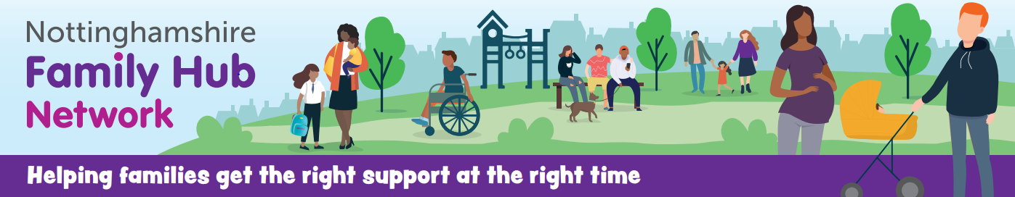
Family Hub Networks in Nottinghamshire
Supporting Families, Children
and Young People

Slide 2
What are Family Hubs?
A Family Hub is a system-wide model of providing high-quality, whole-family, joined up family support services.
Family Hubs deliver these family support services from pregnancy, through the child’s early years and later childhood, and into early adulthood until they reach the age of 19.
Notes:
The creation of Family Hubs is a priority in the Early Help Strategy and Best Start Strategy. The Early Help Strategy is owned by the NSCP and the Best Start Strategy by the HWBB
Health and wellbeing runs throughout – including universal, universal plus, targeted and specialist services.
Family Hubs are about integrated whole family working.

Slide 3
National Principles for Family Hubs
More accessible – through clearly branded and communicated hub buildings, virtual offers and outreach.
Better connected – family hubs drive progress on joining up professionals, services and providers (state, private, voluntary) – through co-location, data sharing, shared outcomes and governance. Moving from services organised for under-fives, to families with children of all ages, reduces fragmentation (even though an emphasis on early years and the ‘Start for Life’ offer will remain).
Relationship-centred – practice in a family hub builds on family strengths and looks to improve family relationships to address underlying issues.

Slide 4
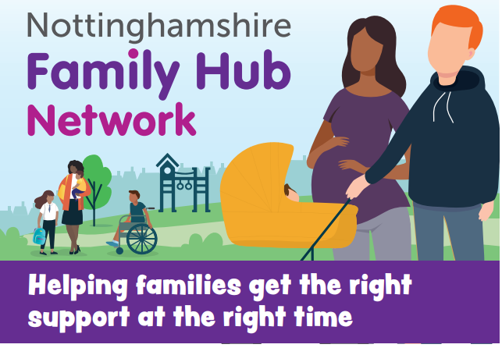
Who are Family Hub Networks for?
All families 0-19
Families who need a helping hand.
Families who need intensive help from targeted services
Families who need extra help from more than one service.
Families who need help to navigate the system

Slide 5
Is this a focus only on buildings?
Hubs are not necessarily about creating new buildings but focus on bringing services together and changing the way family help and support is delivered locally.
In practice, this will be a mix of using children’s centres and other LA spaces, and repurposing other public buildings such as libraries, schools, even high street shops.
A significant proportion of Family Hub services will be delivered virtually through programmes, websites, online resources, texting services etc.
Other services will be delivered in the homes of families themselves – outreach will form an integral part of Family Hubs, overcoming the access barriers many families experience in receiving the support they need.

Slide 6
How do we support families?
The Family Hub Network provides a range of Universal and Targeted services in response to identified need
The priority is prevention and early intervention at levels 2 and 3

Slide 7
We focus on the following outcomes:
Early identification and prevention of risk of harm
Children achieve a Good Level of Development and are ready for learning
Parents are job ready and economically active with increased aspiration for themselves and their children
Improved health and wellbeing of parents and their children.

Slide 8
Our interventions
Universal Services | Stay and Play Under ones BABES – Breastfeeding Support
Family Support | Parenting Programmes Baby Massage Sleep Tight Theraplay 1:1 Support
Ready for Learning | PEEP Forest School Lets Play Little Talkers Now I am Two
Improving Health & Wellbeing | PHEW group Dealing with a Feeling Breastfeeding Support/Weaning
Ready for Work | Volunteering Opening Doors to Confidence

Slide 9
The Family Support Service
Parenting Support
Sleep Support
Routines & Boundaries
Support with Behaviour
Relationships Matter
Domestic Abuse Support
Support for Parents with Bonding and Attachment
Supporting Parents of Children with SEND
Supporting Parents & Children who are isolated due to English as an additional Language
Support or signposting to debt and housing services

Slide 10
Early Years Practitioners
Stay & Play/BABES
Lets Play
Little Talkers 0-1/2-3
Little Learners Creche
Dealing with a Feeling
PEEP – Baby/Toddler
PEEP –Little Sparkles for children with emerging needs
Under 1’s
Forest Schools
Community Development Worker
Outreach
Co-production
Partnership working
Information, Advice and Guidance appointments
Community events
Recruiting and supporting volunteers

Slide 11
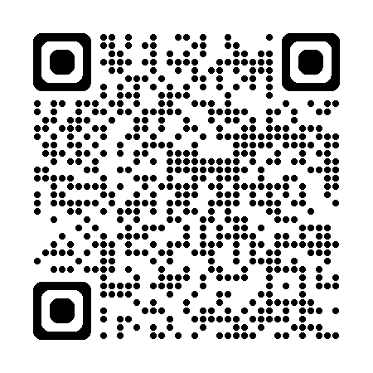
Questions?
For more info please contact:
Family Hub Enquiries: FH.Enquiries@nottscc.gov.uk
Family Hub Network Manager lis.Dixon@nottscc.gov.uk
Family Hub Network Manager Debbie.Marrows@nottscc.gov.uk
Family Hub Early Years Lead Gemma.Clarke@nottscc.gov.uk
Family Hub Child& Family Support Lead Louise.duke2@nottscc.gov.uk
Family Hub Community Development Worker Hazel.O’Connell2@nottscc.gov.uk
Website: Discover your local family hub | Nottinghamshire County Council

