Slide 1





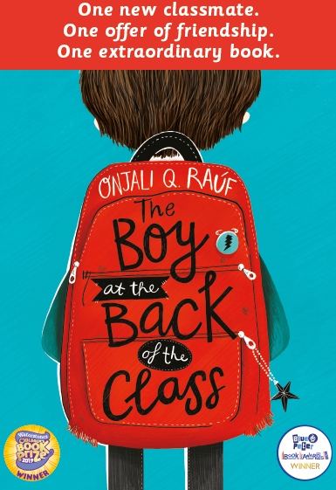
Hello Summer Term!
Welcome to the Summer Term. I hope you have all had a lovely Easter holidays.
This is a busy term for Year 6, not only with SATs not that far away but with lots of exciting and engaging opportunities to end their time at Abbey Gates on a high and ensure the children are ready for the transition into secondary school.
In Year 6, this Summer term, we will be moving onto our CREATE Project, focusing on Art and Music via our Big Question of ‘‘Do we always know how something that we are creating will absolutely turn out?’
In Art, the children will be able to compare and contrast artistic styles using technical language linked to artistic elements, justify their use of artistic elements and different artistic styles to make deliberate choices about their own pieces of art and explain how a piece of art makes them feel using more technical language linked to artistic elements and style to justify their response.
In Music, the children will be able to identify and describe elements of musical shape using technical language, Perform and compose music deliberately and justify their choices and say how a piece of music makes them feel using more technical language of musical shape to justify their response.
PE
PE will take place on a Wednesday and Thursday. Please could all children come to school in their PE kit every Wednesday and Thursday. Please also ensure that long hair is tied back on these days and that children are not wearing any jewellery (especially earrings).
Year 6, Summer Dates
Tue 19th April: SATs Parent Information Meeting
Mon 9th – Thurs 12th May: SATs week
Fri 20th May: Swimming 9 block starts - details to follow
Tues 24th May: Road Safety
Tue 7th June: Bikability starts - details to follow
Tues 21st June: Y5/6 Cricket Tournament - details to follow
Wed 22nd June: Y6 Visit Trent Bridge (Cricket) - details to follow
w/c 11th July: Y5/6 Robin and The Sherwood Hoodies performances- Details to follow
Weds 20th July: Y5/6 British Red Cross Coping with Challenges workshop
Weds 27th July: Last Day of Term
Y5/6 Summer Production:
The Summer term will finish with a bang when the Year 5/6 pupils will have the opportunity to showcase all of their talents in the Upper KS2 production- Robin and the Sherwood Hoodies! All the children will be involved in the production, whether this be speaking on stage, designing scenery or supporting with technology. We will send a letter in due course to give more information about tickets for the performances.
Curriculum Focus
Writing: Recounts, Discussion texts, letters of complaints, informal letters and more.
Reading: The Boy at the Back of the Class
Mathematics: Decimals, percentages, algebra, converting units, perimeter, area and volume, ratio.
PE: Tennis, cricket and athletics.
RE: How do religions and beliefs respond to global issues of human rights, fairness, social justice and the importance of the environment?
Science: Evolution and Inheritance, and Animals including humans
D&T: Mechanical systems: Automata toys
How can you support your children at home?
SATs Support: Make use of the SATs support materials on the school website as shared at parents evening.
Reading: There is still an expectation in Year 6 that children read every night and that their reading record is signed. Make use of the comprehension sentence stems in the Pupil Planner to strengthen their understanding of what they are reading.
Spellings: Spellings should be learnt each week and will be regularly revisited during class. Fortnightly, the new "Focus 5 Spellings“ will be send out. These are based on the Statutory Spelling list which can also be found in the front of your child's Pupil Planner or from their writing in class, and these will be tested every other Friday.
Sticky Questions: These questions encourage discussion. The Year 6 children will be given a different question each week and we will discuss them in class on Friday. Please take some time to discuss these each week.
Class book
Our class book for the Summer term is ‘The Boy at the Back of the Class’ by Onjali Q Rauf. This book is very topical under the world’s current situation as it is a story based around friendship, kindness, and adventure that is centred within the refugee crisis. This book along with our art and music focus will help the children to answer the Big Question of ‘‘Do we always know how something that we are creating will absolutely turn out?’ linking to friendship.
We will continue to regularly update our class pages with relevant information
and updates in regards to the amazing learning that will be taking place. As always, your
continued support is very much appreciated. If you do wish to discuss anything
with us, please do contact the school office or arrange a telephone meeting after
school.
Yours sincerely,
Mr Rich and Mrs Miles

