Slide 1

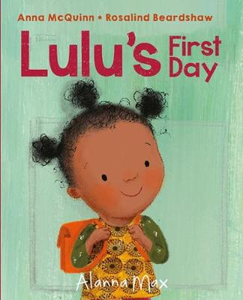





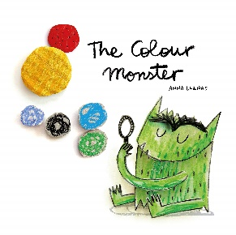

PROJECT PLACEMAT – I WONDER WHAT IS SPECIAL?
Sticky knowledge
I know that I am special. I can tell you something that I enjoy, that I am good at and that I want to work on.
I can talk about how I have changed since I was a baby.
I know that my family are special. I can talk about members of my family when looking at pictures.
I know that I have lots of different feelings. I know when I feel sad, happy, excited or worried and can explain what makes me feel this way. I am beginning to understand how other people feel.
I know that rules are important.
I know and can talk about what I like and do not like. I know that other people don’t always have the same likes and dislikes as me.
I can name my friends. I can say why I like my friend.
I know how to be a good friend and I can share toys with other children.
I can talk about my experiences of familiar celebrations e.g. birthdays, Diwali, Chinese New Year
I can say how I am similar or different to someone else in my class.
Key Questions:
Why am I special?
Who is special to me?
How do I feel?
What do I like? What do other people like?
What is harvest?
What makes a good friend?
The 5 C’s
Confidence – I am confident in my new setting and separating from my grown up.
Cooperation – I work as part of a team in my class to follow rules and play with others.
Courtesy – I am polite and remember to use my manners.
Compassion – I think about how I make other people feel.
Care – I am a good friend.
Key texts

Slide 2
PROJECT PLACEMAT – I WONDER WHAT IS SPECIAL?
Key Vocabulary
Special – something that is important to someone
Family – a group of people that are related and may live together.
Friend – a person that you like to play with, spend time with and trust.
Emotions – a strong feeling such as: happiness, sadness, anger, fear, calm, love
Rules – something that we follow to make the right choice and to keep ourselves safe
Enjoy – something that you like. It might make you feel happy
Dislike – something that you do not like. It might make you feel sad.
Share – to let someone else have something or a part of something.
Taking turns – to each do something or have something for a short time before swapping
Celebration – to do something special or enjoyable for an important event
Similar – being almost, but not exactly, the same
Different – not being the same
Songs you can practise at home each week:
Week 2: Roly Poly https://www.youtube.com/watch?v=7tCvpSPxRK0
Week 3: Twinkle, twinkle, little star
https://www.youtube.com/watch?v=yCjJyiqpAuU
Week 4: The wheels on the bus
https://www.youtube.com/watch?v=e_04ZrNroTo
Week 5: One little blue fish
https://www.youtube.com/watch?v=Qi4AV2S4xA0
Week 6: Tap your sticks
https://www.youtube.com/watch?v=nLfEW3SwpdI
Week 7: If you’re happy and you know it
https://www.youtube.com/watch?v=71hqRT9U0wg

