Slide 1

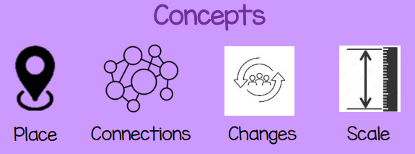


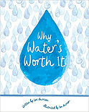
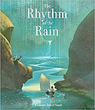
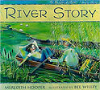
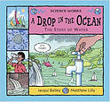
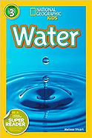

EXPLORE PROJECT PLACEMAT – How does the Earth’s surface change?
Sticky Knowledge
The start of a river is called the source and the end is called the mouth.
A fast flowing river will carry soil and dirt from its banks and bed downstream and drop them when it gets wider and slows down.
The longest river in the world is the Nile in Africa. It is 4,130 miles long.
Many rivers and streams will join together before they reach the mouth of the river. The smaller rivers and streams are called tributaries.
Mountains make up one-fifth of the world’s landscape.
Mount Everest is the world highest mountain and it is 8,850m high.
There are mountains under the surface of the sea.
80% of our fresh water originates from mountains.
The highest 14 mountains in the world are all found in the Himalayas.
Generally mountains are higher than 600m, if they are less they are called hills.
Crucial Connections
https://abbeygatesprimaryschool.co.uk/about/e-safety/
https://www.3dgeography.co.uk/geography-of-the-uk
https://www.rgs.org/schools/teaching-resources/map-skills/
Reading Recommendations

Slide 2
Possibilities
River management, environmental officer, agriculture, hydrologist,
marine biologist, oceanographer, mountain climber
Important Ideas
Diversity
Possibilities
Cycles
Subject Specific Vocabulary (Rivers)
Estuary- An estuary is an area where a freshwater river or stream meets the ocean.
Mouth-A river mouth is the part of a river where the river flows into another river, a lake, a reservoir, a sea, or an ocean.
Source-The source of a river is where it begins, usually on high ground.
Meander-A meander is a winding curve or bend in a river.
Waterfall-Waterfalls form where water rushes down steep hillsides in upland areas and erodes the rocks.
Erosion-Erosion occurs when the fastest currents in the river carve into the banks.
Deposition-Rocks and sediments eroded from one part of the river are deposited in another part.
Tributary-When one stream or river meets another and merge together, the smaller stream or river is known as a tributary.
Ox bow lake- Ox bow lakes are created when the meander is so deep that it cuts off a piece of the river and leaves a lake.
Delta- Deltas are wide areas of water often found at the mouth of large rivers.
Stream- A stream is a small body of flowing water.
Subject Specific Vocabulary (Mountains)
Peak- The peak is the highest point of any mountain.
Valley- A valley is a long depression, or ditch, in the Earth's surface and usually lies between ranges of hills or mountains.
Cliff- Cliffs are tall, steep rocks that were created by erosion and have vertical faces.
Ridge- A ridge is part of the steep, sloping side of a mountain.
Plateau- A plateau is an area of flat ground that is much higher than the surrounding area.
Summit- The summit is the highest point of a mountain.
Hill- A hill is a landform that is high but not high enough to be a mountain.
Terrain- Terrain is used as a general term when referring to the lie of the land.
Range- A mountain range is a group or chain of mountains that are close together.
Tectonic plates- The Earth's outer layer is made up of large, moving pieces called plates.
Fold mountains- Fold mountains are formed when two plates run into each other or collide.

