Slide 1





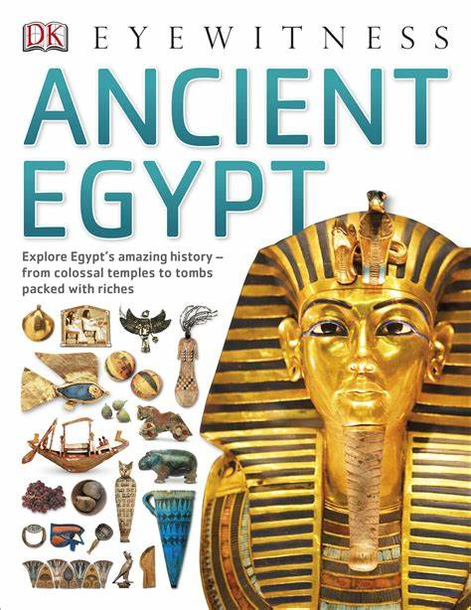
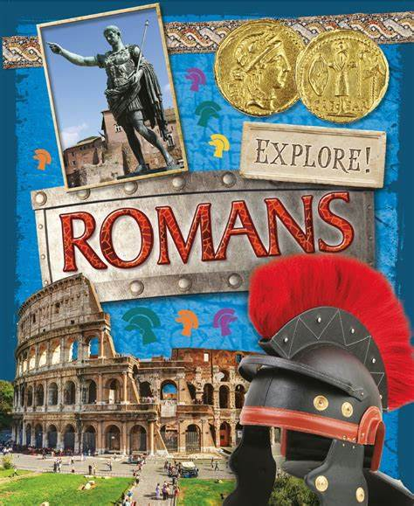
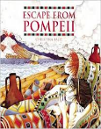
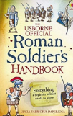
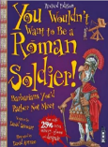
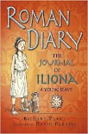
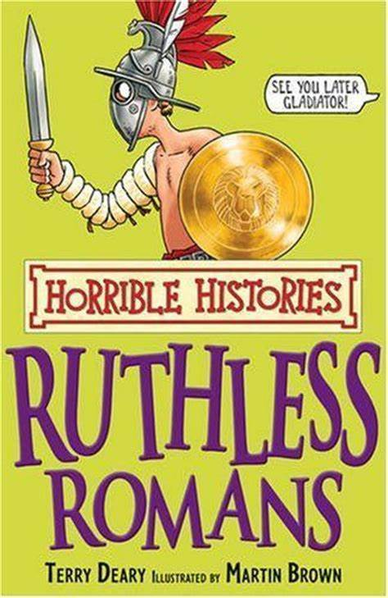
DISCOVER: Have we advanced or regressed since ancient times?
Sticky Knowledge
The Ancient Egyptian Civilisation started around 7500BC and came to an end in 30BC.
The River Nile runs through Egypt and is where the ancient civilization began.
The Egyptians were the first civilisation to invent writing and paper.
Cleopatra was the last pharaoh of Egypt before the Romans took over.
Tutankhamen was known as the boy king, his tomb was discovered in 1922.
The ancient Egyptians worshipped over 2,000 gods and goddesses.
According to legend, Rome was created by brothers, Romulus and Remus in 753BC.
Julius Caesar extended the Roman empire by invading other lands including an attempted invasion of Britain in 55-54 BC.
Emperor Claudius, successfully invaded Britain in 43 AD.
British Iceni tribe leader, Boudicca led a resistance against the Roman Empire.​
The Roman’s built Hadrian’s Wall across the top of Britain to keep the Scots out.
We still use roads which the Roman built.
▪
Important Ideas
Advancement
Regression
Ancient
Civilisation
Source
Chronology
Crucial Connections
https://www.bbc.co.uk/bitesize/topics/zg87xnb
https://www.bbc.co.uk/history/ancient/egyptians/
https://www.bbc.co.uk/bitesize/topics/zwmpfg8
https://www.bbc.co.uk/history/ancient/romans/
Reading Recommendations

Slide 2
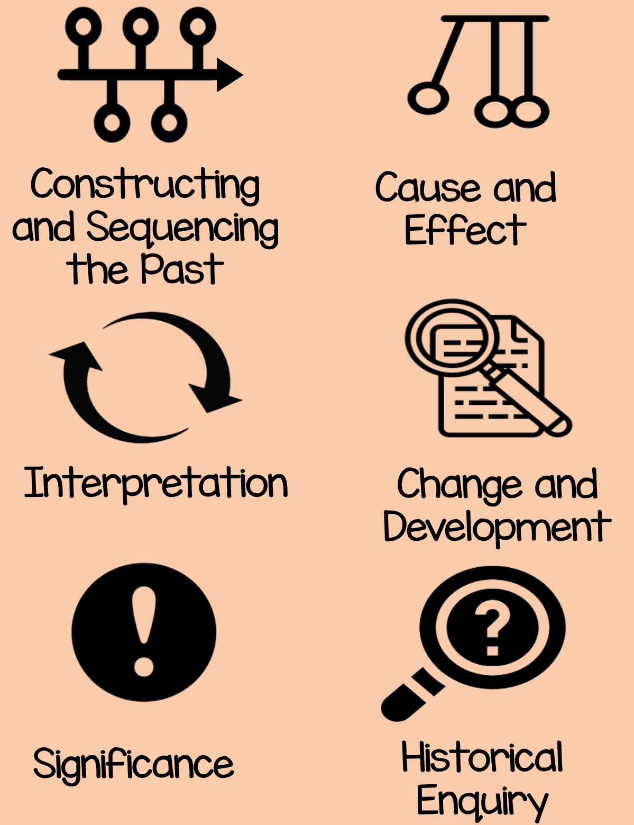
Possibilities
Historian, Archeologist, Museum Curator, Teacher, Librarian, Carpenter, Stone Mason, Politician, Journalist, Attorney
Subject Specific Vocabulary
(Ancient Egyptians)
Archaeologist - People who discover our history by looking at artefacts that have been found.
Pharaohs - The word pharaoh originally meant ‘great house’, but came to mean the person who resided in it.
Tombs - Ancient Egypt is known for its magnificent and beautiful tombs. The most well known are within the pyramids in the Valley of the Kings.
Pyramid - A geometrical term that refers to part of the burial complexes for Egyptian pharaohs.
Hieroglyphs - The term hieroglyph refers to the fact that it is carving for sacred things, but hieroglyphs were also written on papyrus.
Vizier - The vizier in ancient Egypt was the most powerful position after the king. A vizier was the equivalent of a modern day prime minister.
Scribe - A scribe recorded in writing the everyday life and extraordinary happenings in ancient Egypt.
Sarcophagus - Sarcophagus is a Greek word meaning flesh-eating and refers to the mummy case.
Mummy - Remains of a body found inside the carved and brilliantly painted burial case known as a sarcophagus.
Papyrus - An Egyptian plant whose reeds are slit and placed in layers in order to form paper.
Scarab - Scarabs are amulets formed to look like the dung beetle, an animal associated by the ancient Egyptians with life, rebirth and the sun god Re.
Subject Specific Vocabulary (Romans)
Centurion - A commander of a group of 100 Roman soldiers.
Emperor - The Roman leader of the Roman Empire during the imperial period.
Aqueduct - A large system, like a bridge, for carrying water from one place to another is called an aqueduct.
Gladiator - A gladiator was an armed fighter who entertained audiences in the Roman Republic.
Londinium - This was the Roman name for London.
Conquer - To overcome and take control of people or land using military force.
Invade - Enter a place or land with the intention of occupying it.
Romanisation - When the countries that the Romans conquered became very much like Rome.
Senate - Similar to the Roman version of our parliament.
Roman baths - A number of rooms designed for bathing, relaxing, and socialising, as used in ancient Rome.
History Concepts

