Slide 1


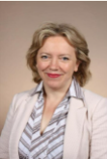
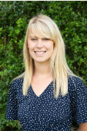
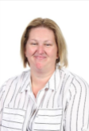
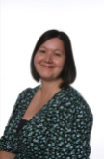
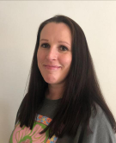
Abbey Gates Primary School
Pastoral Team
Mrs Quant-Epps
Miss Taylor
The kitchen staff
The office staff
Who can I talk to in school?
A teacher or teaching assistant
A member of the play team
Pupil Parliament
Mrs Durham
Mrs Smith
Miss Muzeja
… or any other adult in school that you trust to help you ☺

