Slide 1
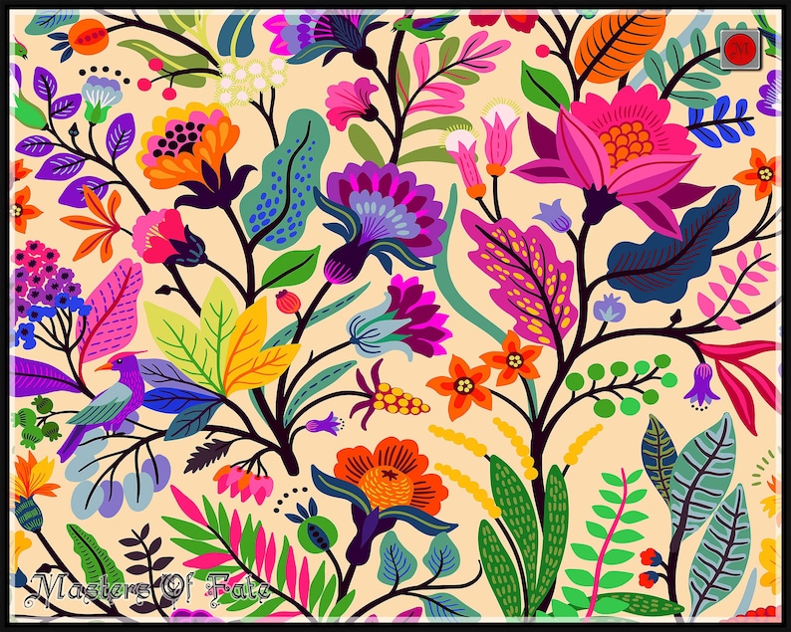


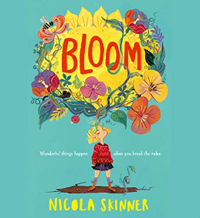
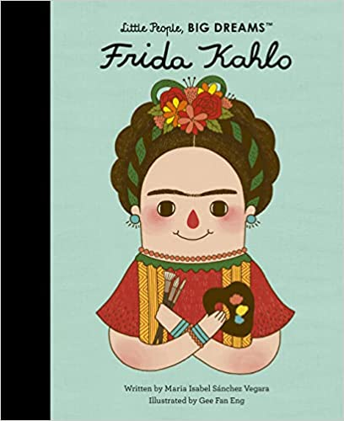



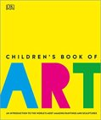
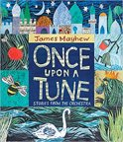

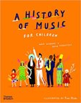
YEAR 4 CREATE PROJECT PLACEMAT – Who owns art when it is finished?
Art – Sculpture and 3D Shape
The most important people were often the largest object in Ancient Egyptian paintings
People were always painted from the side
Ancient Egyptian paintings are painted in 2D (flat images) with no perception of 3D form
They used white, black, red, yellow, green and blue. These colours came from minerals they would find around the area they lived in
Art - Craft and Design
Symmetry can be used to create repeating patterns
Patterns can be irregular, and change in ways you wouldn’t expect
The starting point for a repeating pattern is called a motif, and a motif can be arranged in different ways to make varied patterns
Texture can be used purposely to achieve a specific effect or to replicate a natural surface
Simple structures can be made stronger by adding layers, folding and rolling.
Music​
Know the meaning of dynamics (loud/quiet) and tempo (fast/slow)​
Recognise and demonstrate changes in dynamics and tempo (e.g., crescendo, decrescendo, pause)​
​
Respond to changes in pitch with actions (e.g. stand up/sit down, hands high/hands low)​
​
Represent rhythm patterns using stick notation including crotchets quavers crotchets rests
Sticky Knowledge
Useful Links
Art
https://www.tate.org.uk/kids
http://www.robbiddulph.com/drawwith-rob
https://kinderart.com/
https://www.crayola.com/athome
Music
https://www.classicsforkids.com/
https://schoollearningzone.co.uk/key_stage_two/k
s2_music/ks2_music.htm
Reading Recommendations

Slide 2
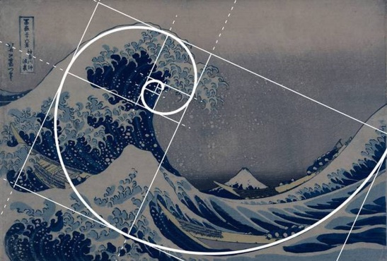
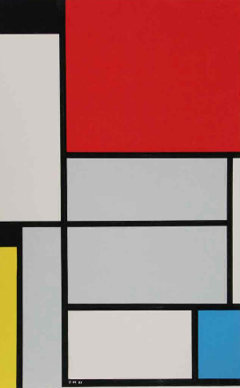




Art Concepts
Music Concepts
Composition
Composition
Communication
Comprehension
Construction
Expression
Technique
Art: Artist, Illustrator, Graphic Designer, Art Teacher, Sculptor, Fashion Designer, Architect
Music: Singer, Music Teacher, Composer, Conductor, Performer, Music Promoter, Radio DJ, Producer, Tour Manager
Possibilities
Art - Sculpture and 3D
Ceramics | Pots and other articles made from clay hardened by heat
Figurative | An abstract representation of the human figure, which is altered or distorted
Hollow | Having a hole or empty space inside or form by making a hole
Organic shape | Figures that have a natural look and a flowing, curving appearance such as shapes found in nature
Quarry | A large pit from where stone and other materials are excavated
Template | A template is a form, mold or pattern used as a guide to make something
Visualisation | The formation of a mental image of something.
Subject Specific Vocabulary
Music – Whole School Vocabulary
Pulse | The regular heartbeat of the music; the steady beat.
Rhythm | Long and short sounds or patterns that happen over the pulse, the steady beat.
Pitch | High and low sounds
Tempo | The speed of the music – fast, slow or in-between.
Dynamics | How loud or quiet music is
Timbre | All instruments, including voices have a certain sound quality, eg the trumpet has a very different sound quality to the violin.
Texture | Layers of sound working together make music very interesting to listen to.
Structure | Every piece of music has a structure, e.g introduction, verse, chorus, ending.
Art – Craft and Design
Batik | A technique to create patterns on fabric
Colour palette | Something creative and useful
Design | A decorative pattern or drawing of what something might look like
Industry | Companies and activities that design and make products, sometimes in a factory
Pattern | A design in which shapes, colours or lines are repeated
Repeat | When the same thing occurs more than once
Theme | Similar ideas that work together as a group
Music – Other words we need to know in Year 4
crescendo, decrescendo, pause, improvise, question and answer phrases, graphic symbols, dot notation, stick notation, crotchets, quavers, crotchet rest, melodic phrase, tuned percussion

