Slide 2
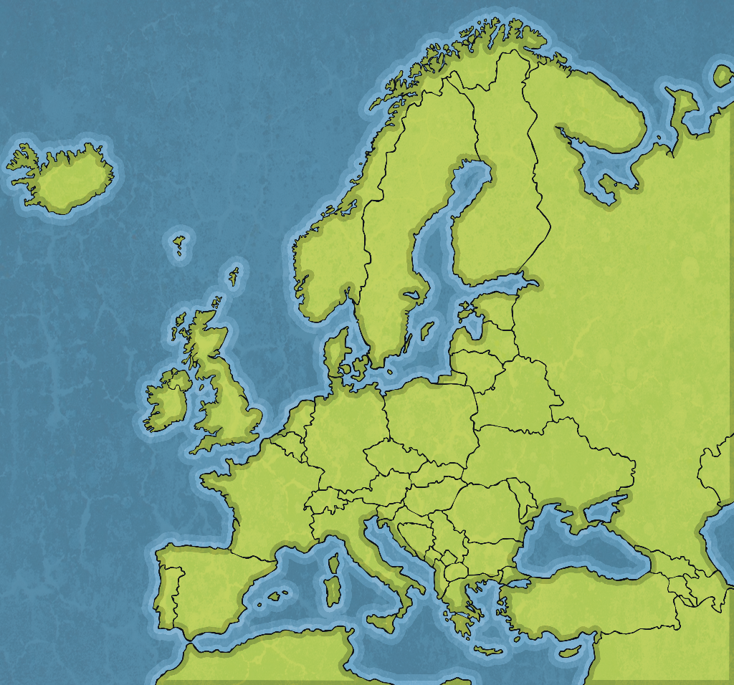
Who Was
Friedensreich Hundertwasser?
Friedensreich Hundertwasser was a famous artist and architect, born in Austria in 1928. He was born as Friedrich Stowasser, but liked to be known by his pseudonym, Friedensreich Hundertwasser.
Austria

Slide 3
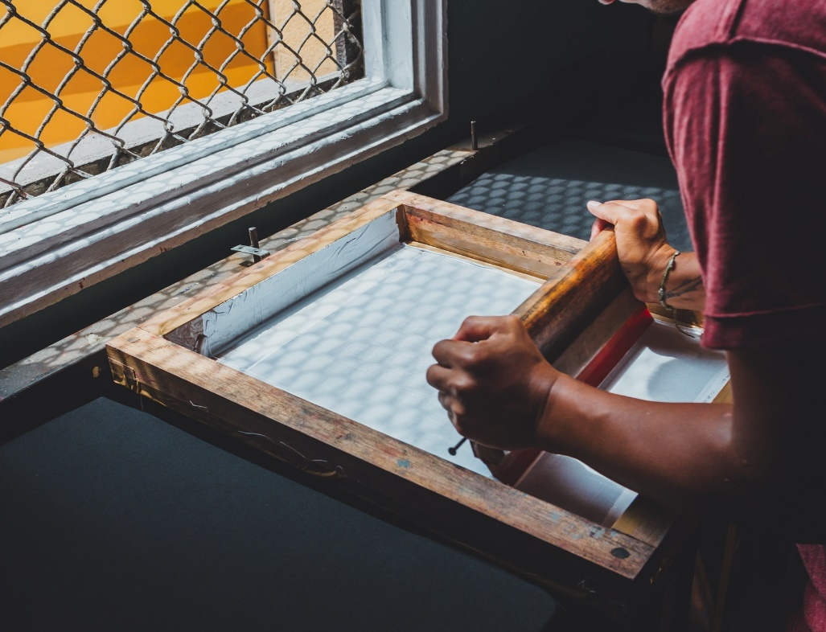
Early Life
Hundertwasser became interested in art from an early age. As a young man, he left Austria to travel, and carried a small set of paints in his pocket so that he could record anything that interested him, wherever
he went.
He also began experimenting
with other techniques such
as lithography, screen printing and woodcuts.

Slide 4
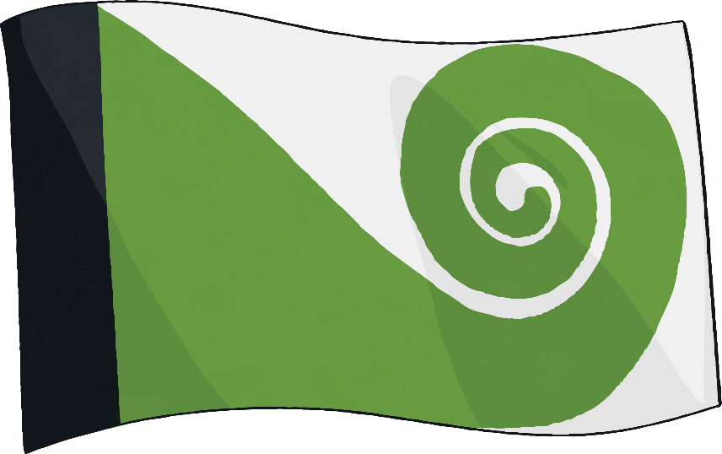
Early Career
Hundertwasser studied at the Academy of Fine Arts in Vienna, after the war. He held his first successful art exhibition in 1952.
His style of painting was very unique. He preferred using lots of bold colours, uneven lines and often made his own paints. He was influenced by the artists Antoni Gaudi and Gustav Klimt.
As well as painting, he created designs for flags, posters, stamps
and coins.

Slide 5
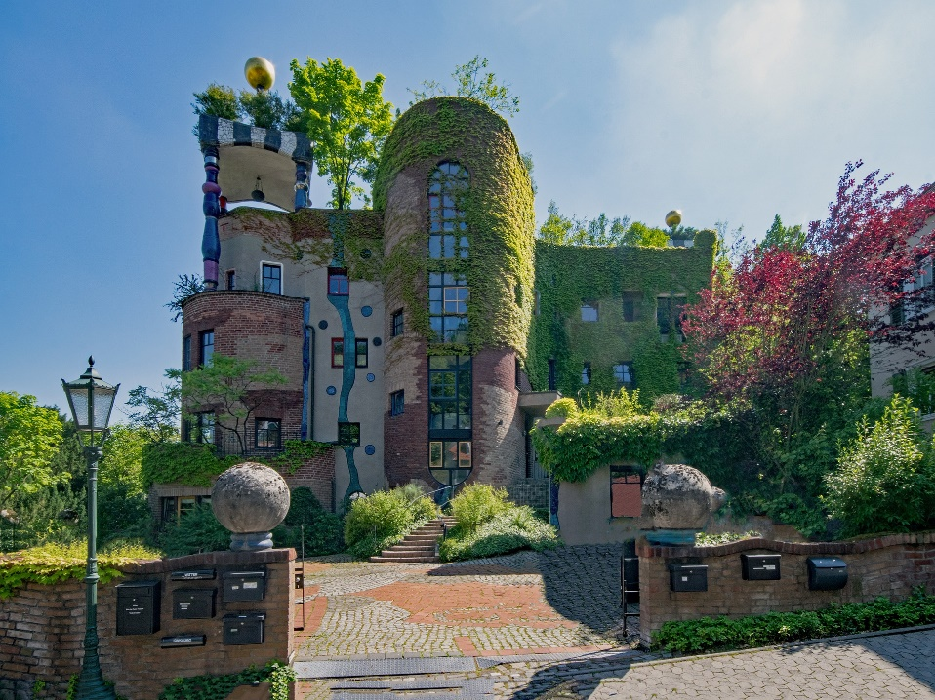
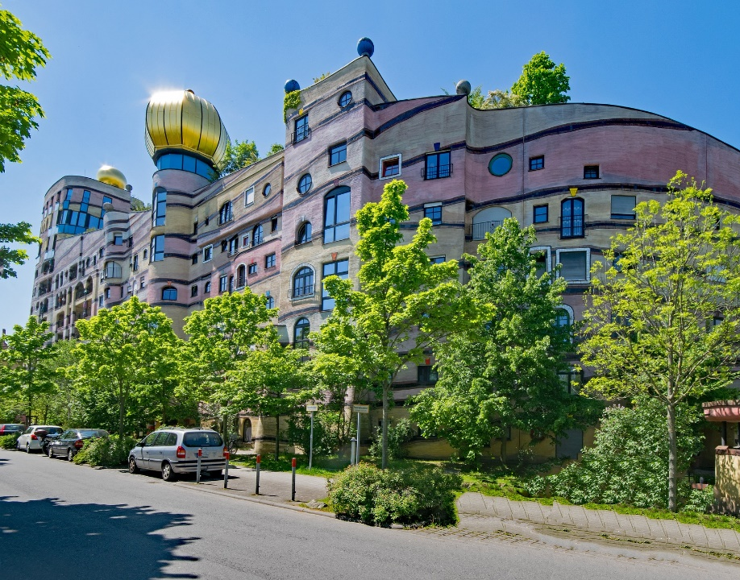
Architecture
By the mid 1960s, Hundertwasser had become well known for his art and was branching out into architecture.
He designed many buildings with curved features rather than straight lines, like this one in the Hot Springs Village in Austria.

Slide 6
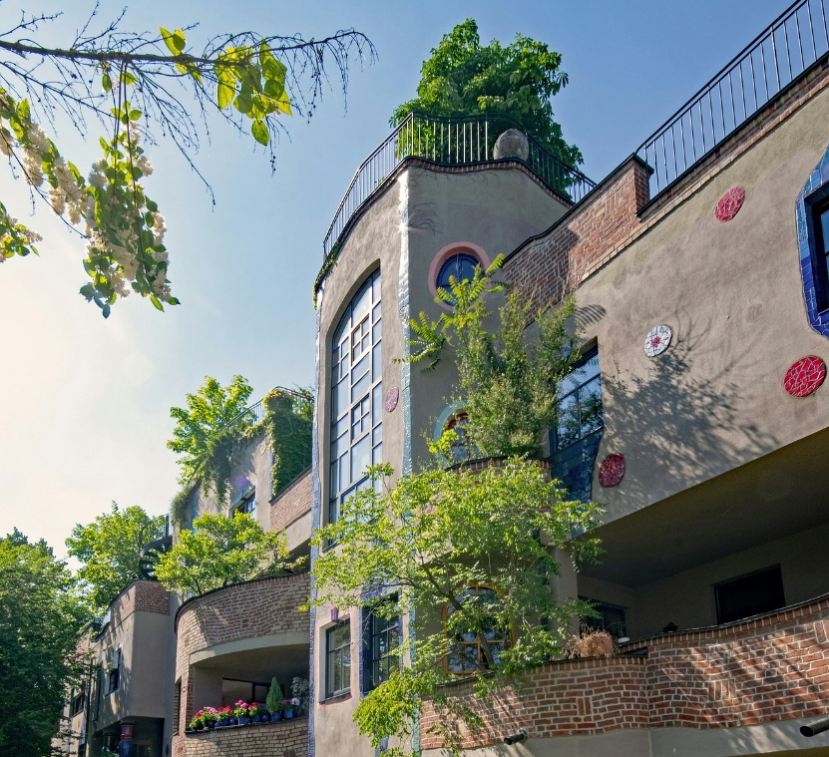
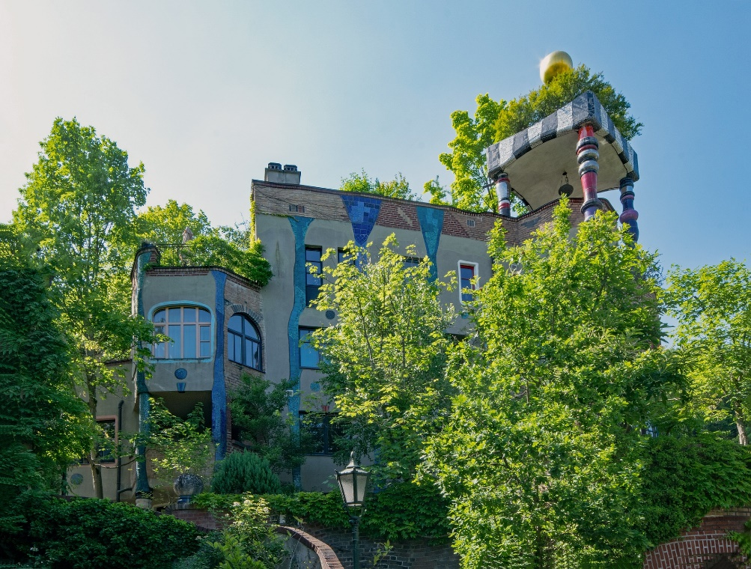
His Love of Nature
Hundertwasser was influenced very much by nature. He believed that humans and nature should live in harmony and incorporated grass, trees and plants into many of his designs. He noticed there were no straight lines in nature. The Waldespirale in Germany has a grass roof and trees growing out of windows. Its name means ‘forest spiral.’

Slide 7
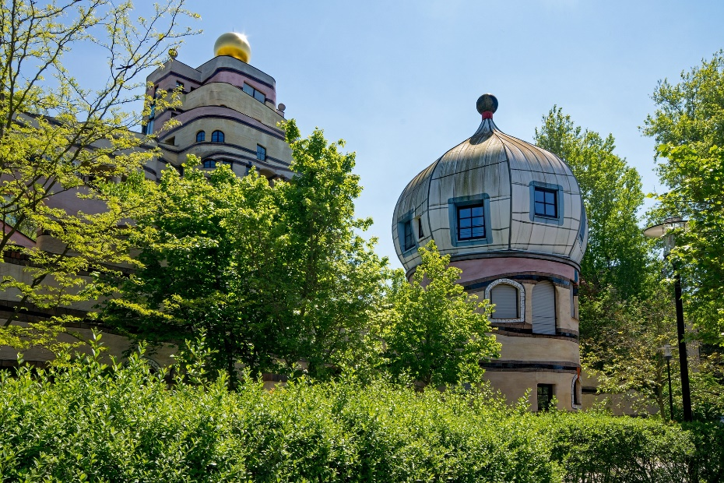
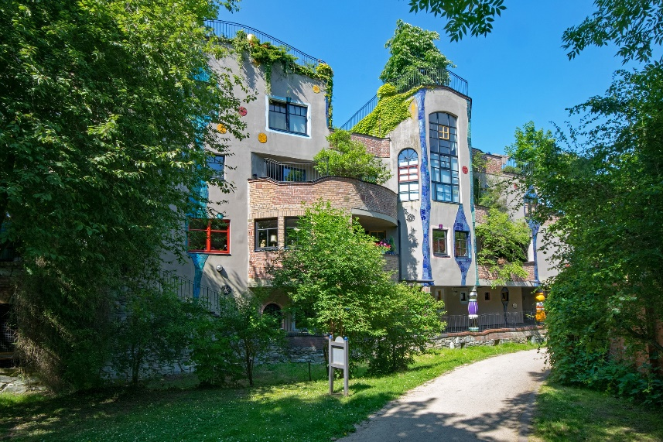
His Beliefs
“There are no evils in nature. There are only evils in man.”
- Friedensreich Hundertwasser
Hundertwasser was keen to protect nature. He once planted 150,000 trees in the valley on his estate and also protested against the development of nuclear weapons. Many of his artworks had a theme of protecting the environment, e.g. ‘Save the Whales’ and ‘Save the Seas’.

Slide 8
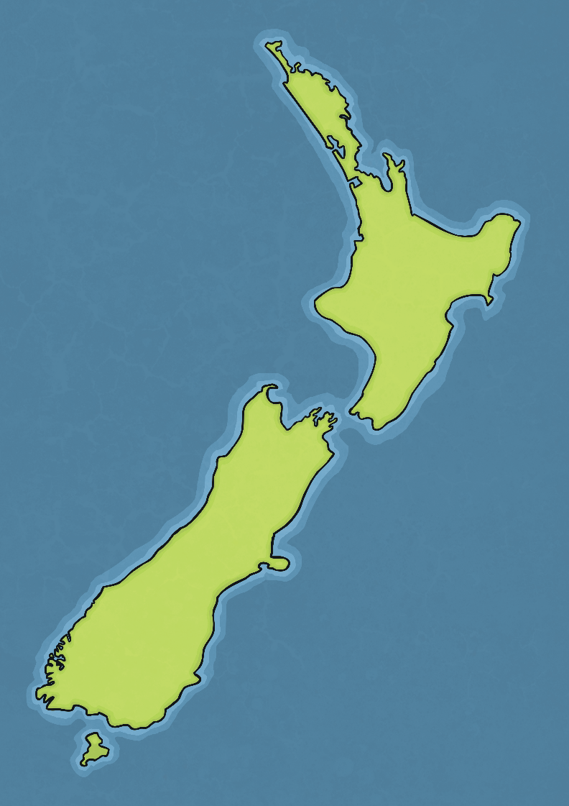
Later Life
Friedensreich Hundertwasser spent the last 20 years of his life in
New Zealand.
His only child, Heidi Trimmel, was born in 1982, when he was 64
years old.
He died on a cruise ship, aged 71, and was buried in the ‘Garden of the Happy Dead’ in New Zealand.

Slide 9
Interesting Facts
Hundertwasser believed clothing should be unique to an individual and often wore mismatched socks.
The name he gave himself, Friedensreich Hundertwasser, means “full-of-peace hundred-water”.
He even designed a toilet, the Hundertwasser in New Zealand!
He didn’t paint at an easel; he spread paper or canvas on the floor to
work on.
Many people say his work is like that of a child, but he believed children’s creativity was the ‘truest’ form, because it was not influenced by experience.

