Slide 1
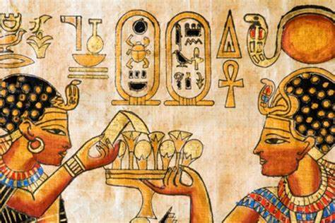

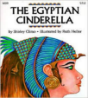
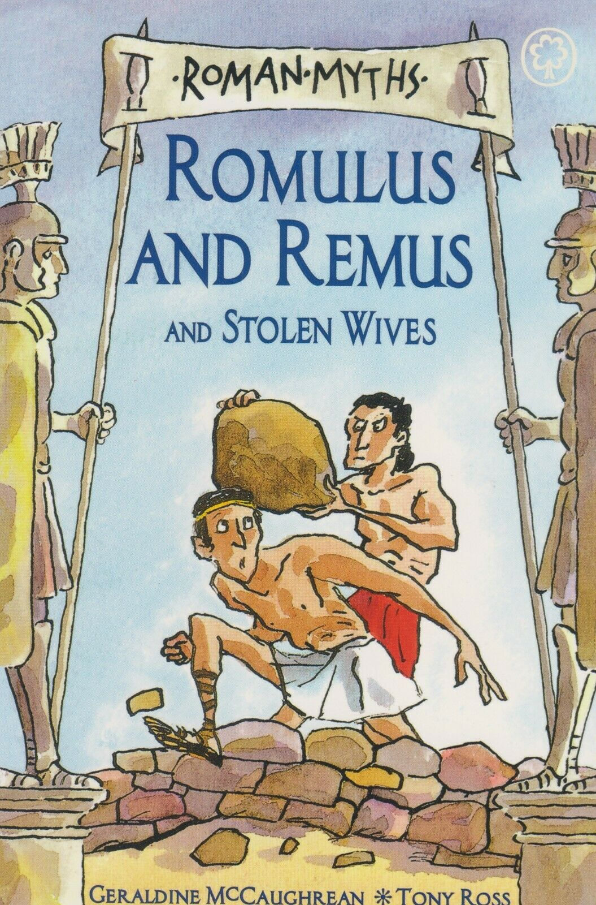




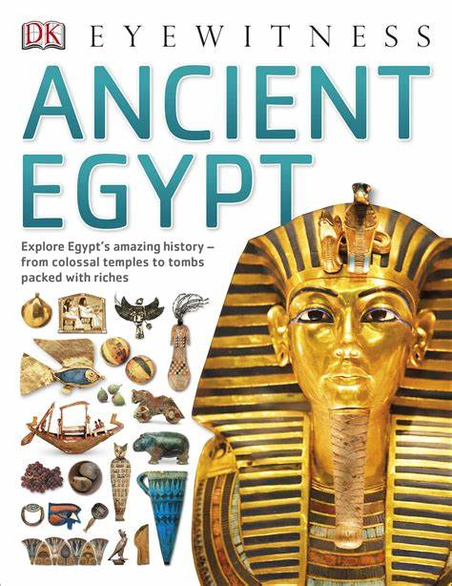
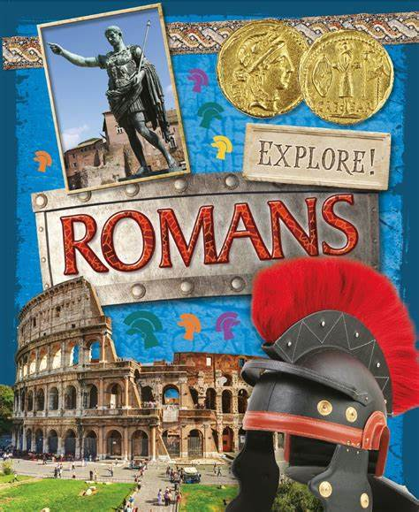
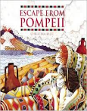
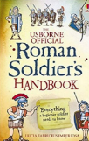
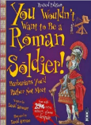
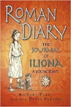
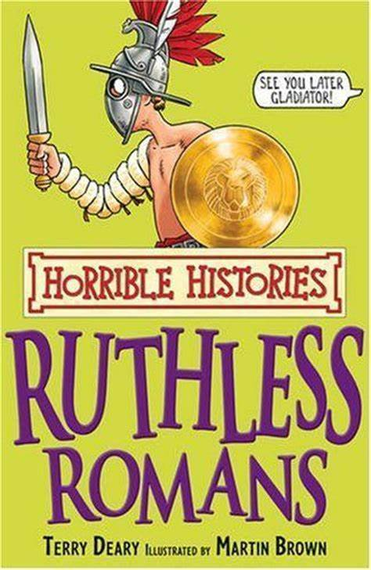
DISCOVER PROJECT PLACEMAT – Have we advanced or regressed since ancient times?
Sticky Knowledge
-Cleopatra was the last pharaoh of Egypt before the Romans took over.
-Tutankhamen was known as the boy king, famous because his tomb was found in 1922.
-Egyptian men and women wore make-up.
-The Egyptians were the first civilisation to invent writing.
-A legend tells that Rome was created by two brothers, Romulus and Remus who were abandoned after they were born.​
-Julius Caesar was probably the best known Roman leader. He extended the empire by invading other lands.​
-Romans used to eat food like dormice dipped in honey.​
-Romans occasionally used a spoon, but they would never use a knife and fork. Rich Romans liked to eat exotic food, such as stork, roast parrot and even flamingo!​
-Boudicca was a queen of the British Celtic Iceni Tribe who led an uprising against the occupying forces of the Roman Empire.​
Important Ideas
Slavery
Wealth
Key Texts
Crucial Connections
https://www.bbc.co.uk/bitesize/topics/zg87xnb
https://www.bbc.co.uk/history/ancient/egyptians/
https://www.bbc.co.uk/bitesize/topics/zwmpfg8
https://www.bbc.co.uk/history/ancient/romans/
Reading Recommendations

Slide 2
DISCOVER PROJECT PLACEMAT – Have we advanced or regressed since ancient times?
Subject Specific Vocabulary (Ancient Egyptians)
Archaeologist - People who discover our history by looking at artefacts that have been found.
Pharaohs - The word pharaoh originally meant ‘great house’, but came to mean the person who resided in it.
Tombs - Ancient Egypt is known for its magnificent and beautiful tombs. The most well known are within the pyramids in the Valley of the Kings.
Pyramid - A geometrical term that refers to part of the burial complexes for Egyptian pharaohs.
Hieroglyphs - The term hieroglyph refers to the fact that it is carving for sacred things, but hieroglyphs were also written on papyrus.
Vizier - The vizier in ancient Egypt was the most powerful position after the king. A vizier was the equivalent of a modern day prime minister.
Scribe - A scribe recorded in writing the everyday life and extraordinary happenings in ancient Egypt.
Sarcophagus - Sarcophagus is a Greek word meaning flesh-eating and refers to the mummy case.
Mummy - Remains of a body found inside the carved and brilliantly painted burial case known as a sarcophagus.
Papyrus - An Egyptian plant whose reeds are slit and placed in layers in order to form paper.
Scarab - Scarabs are amulets formed to look like the dung beetle, an animal associated by the ancient Egyptians with life, rebirth and the sun god Re.
Possibilities
Historian, Archeologist, Museum Curator, Teacher, Librarian, Carpenter, Stone Mason, Politician, Journalist, Attorney
Subject Specific Vocabulary (Romans)
Centurion - A commander of a group of 100 Roman soldiers.
Emperor - The Roman leader of the Roman Empire during the imperial period.
Aqueduct - A large system, like a bridge, for carrying water from one place to another is called an aqueduct.
Gladiator - A gladiator was an armed fighter who entertained audiences in the Roman Republic.
Londinium - This was the Roman name for London.
Conquer - To overcome and take control of people or land using military force.
Invade - Enter a place or land with the intention of occupying it.
Romanisation - When the countries that the Romans conquered became very much like Rome.
Senate - Similar to the Roman version of our parliament.
Roman baths - A number of rooms designed for bathing, relaxing, and socialising, as used in ancient Rome.

