Slide 1
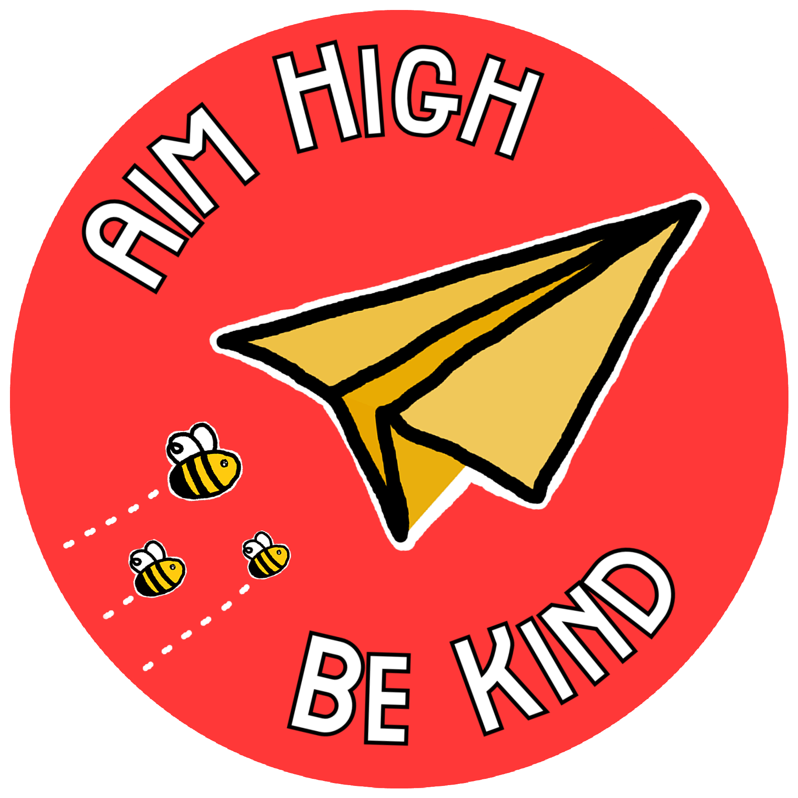

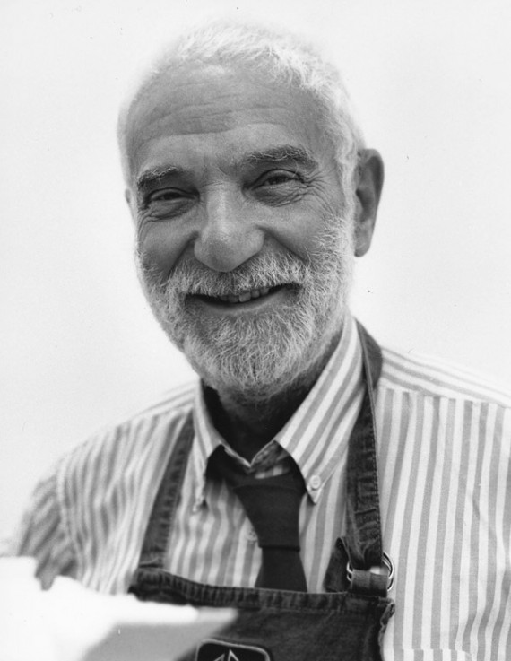
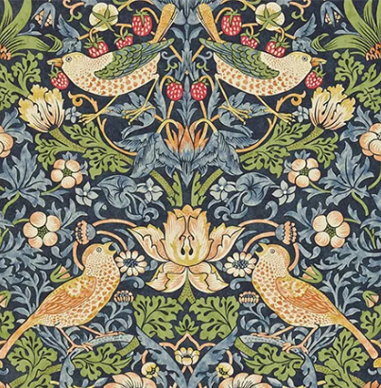
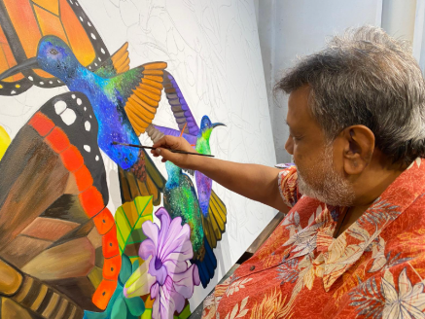
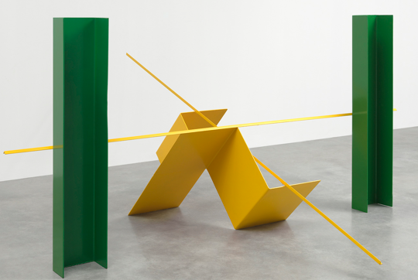
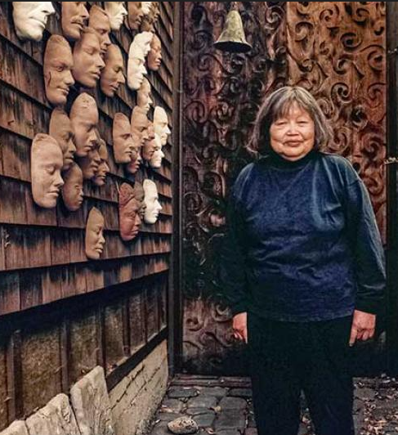
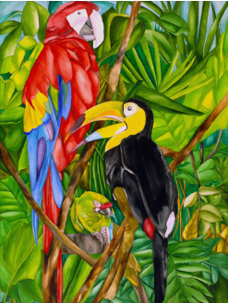
PROJECT PLACEMAT – CREATE
Is art made, or is it already there?
Sticky Knowledge
Recommended artists
ART
Sculpture & 3D: Abstract shape
To know that three-dimensional forms are either organic (natural) or geometric (mathematical shapes, like a cube).
To know that organic forms can be abstract.
To know that artists can focus on shapes when making abstract art.
To know artists, use light and dark colours next to each other to create a contrast
To know that negative shapes show the space around and between objects.
To know that artists make decisions on how to present their sculptures
Craft and design: Fabric of nature
To know how to use basic shapes to form more complex shapes and patterns.
To know that symmetry can be used to create repeating patterns.
To know that patterns can be irregular and change in ways you wouldn’t expect.
To know that a mood board is a visual collection which aims to convey a general feeling or idea.
To know that batik is a traditional fabric decoration technique that uses hot wax.
MUSIC
To know that notation is a way to represent music visually.
To know a Crotchet = 1 beat (quarter note)
To know a Minim = 2 beats (half note)
To know Paired Quavers = ½beat (eighth notes)
To know that allegro = fast and adagio = slow
To know forte = loud and piano = soft
To know how to use dot notation to show higher/lower pitch
To know that timbre is the quality and character of a sound.
To know that texture is the layers of sound in music
Anthony Caro
William Morris
Senaka Senanayake
Ruth Asawa
Ruth Daniels
Possibilities
Art: Community Arts worker, Art Therapist, Teacher, Animator, Architect, Art Gallery Curator, Graphic Designer, Fashion Designer, Florist, Furniture Designer, Game Designer, Illustrator, Jewellery Maker, Photographer, Set Designer
Music: DJ, Music Therapist, Musical Instrument Maker/Repairer, Radio Broadcast Assistant, Stage Manager, Sound Engineer, Teacher, Composer, Exhibition Designer

Slide 2
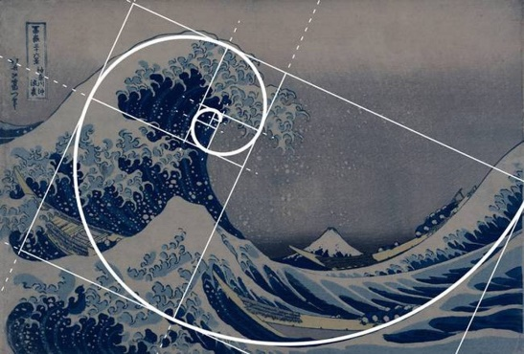

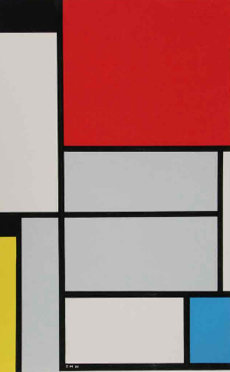
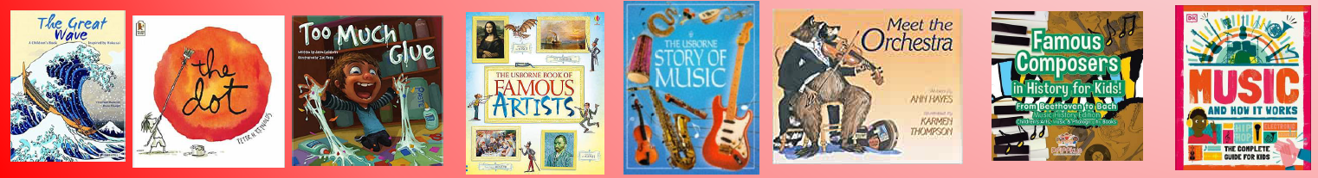



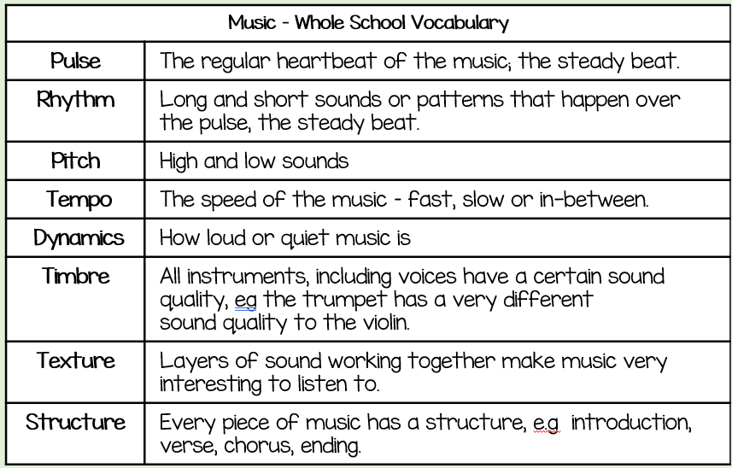

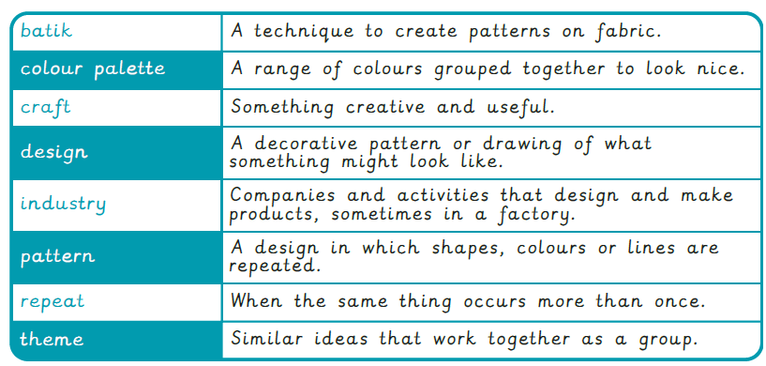
Composition
Communication
Comprehension
Reading Recommendations
Art
Concepts
Music Concepts
Construction
Expression
Technique
Art
Sculpture and 3D
Subject Specific Vocabulary
Music
Craft and Design
Music – Other words we need to know in Year 3
Allegro, Adagio, Beat/Pulse, Forte, Piano, Unison, Minim, Paired, Question and Answer, Pitch

Slide 3


